Slide 10
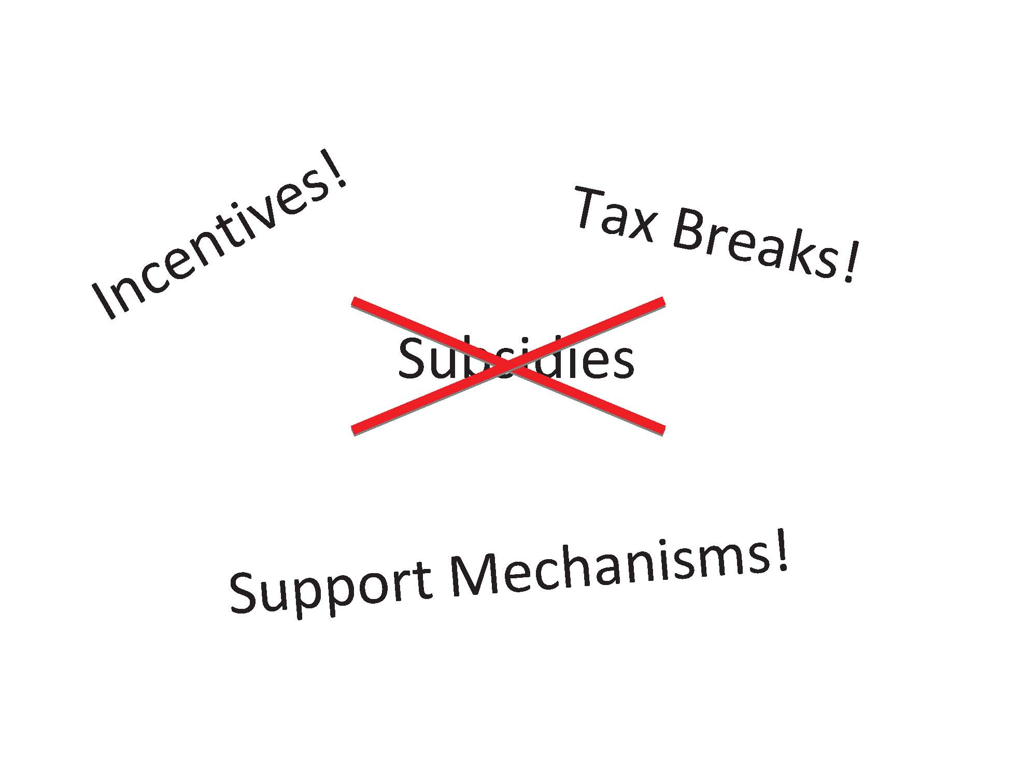

Slide 15
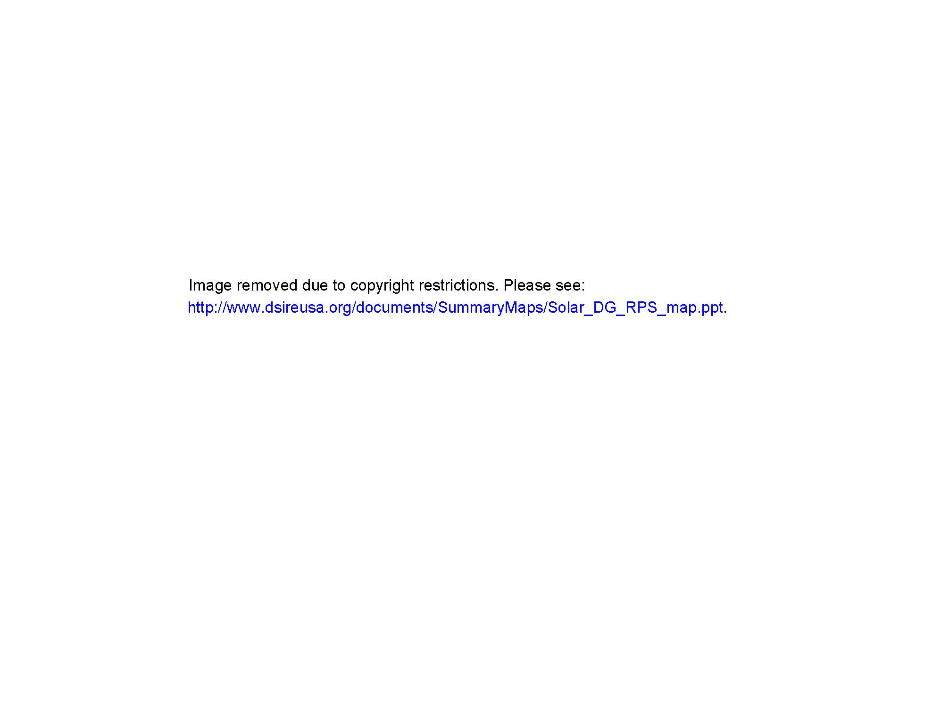

Slide 16
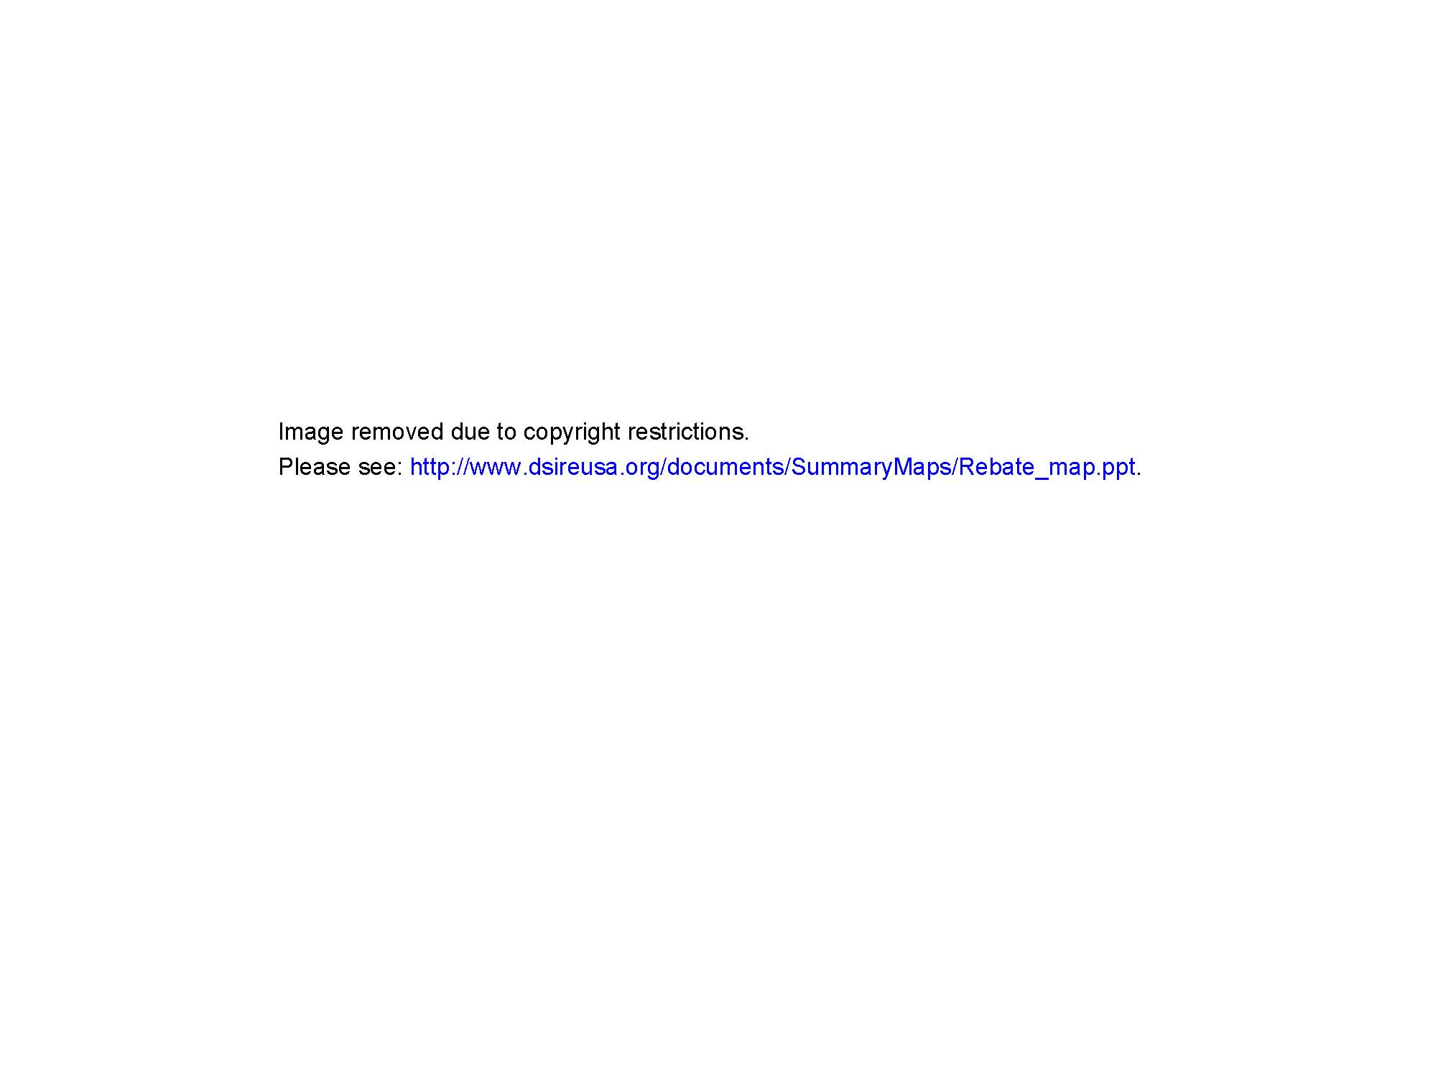

Slide 23
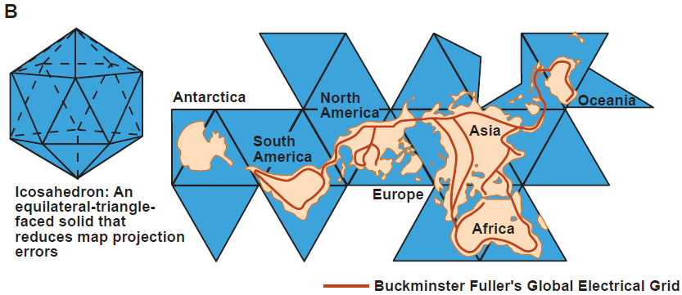

Slide 24
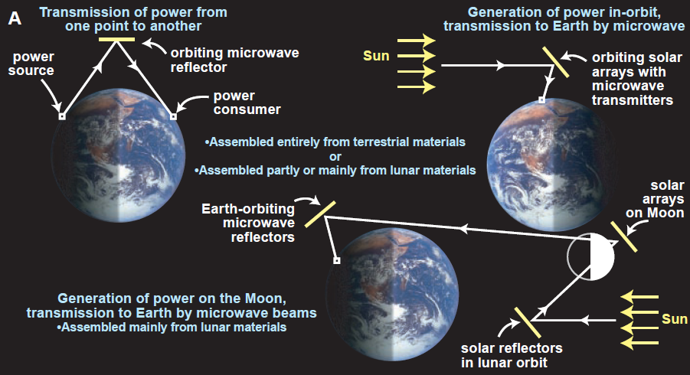

Slide 26
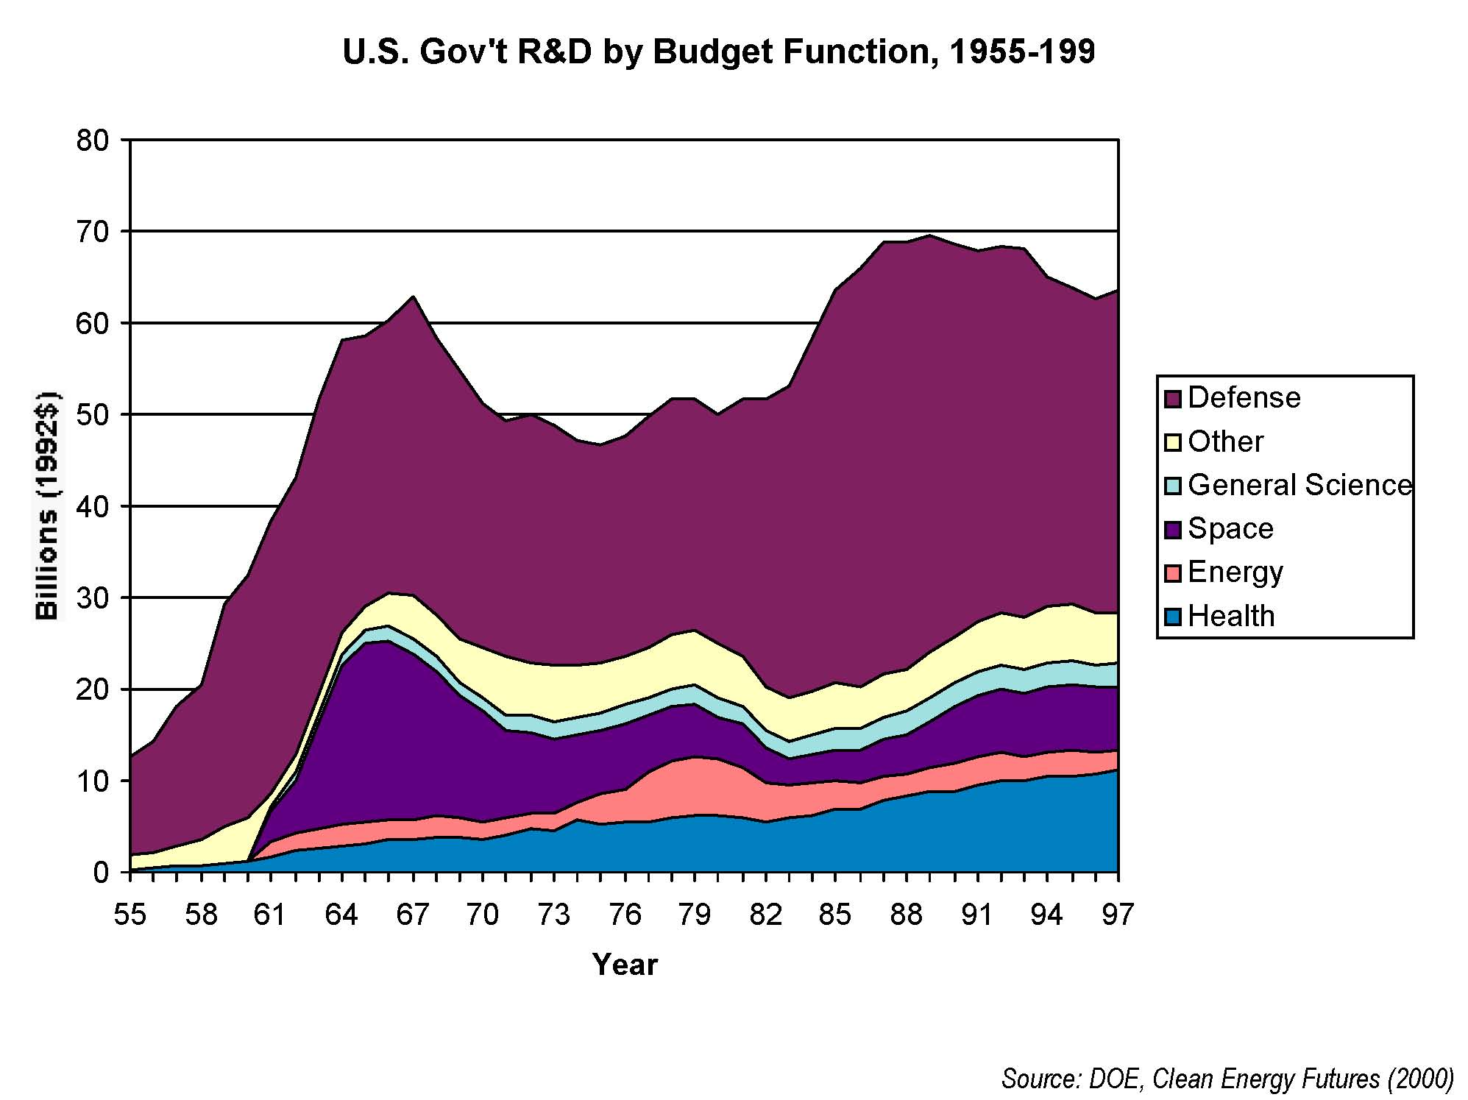

Slide 28
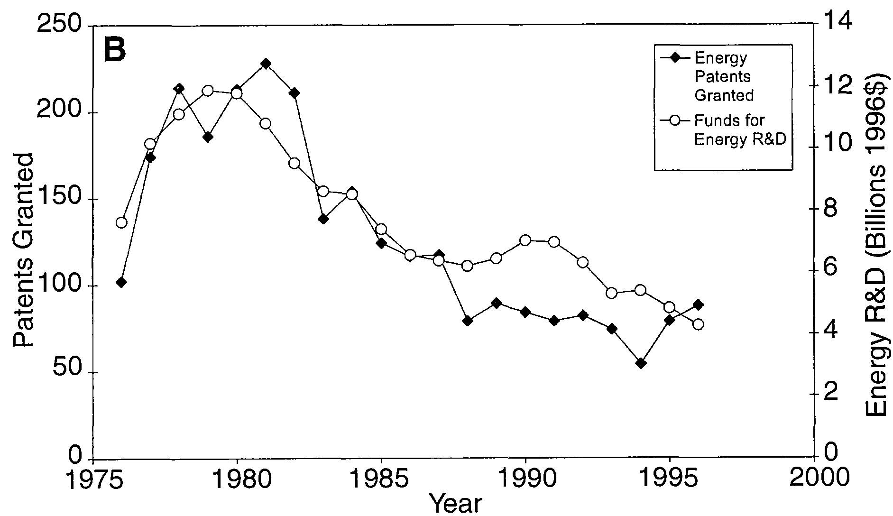

Slide 29
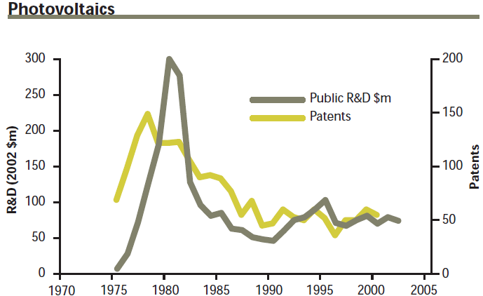

Slide 30
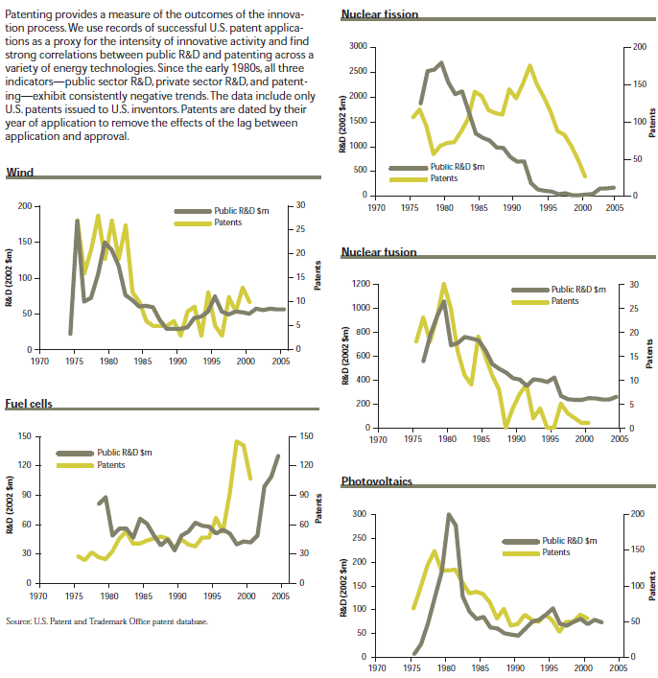

Slide 31
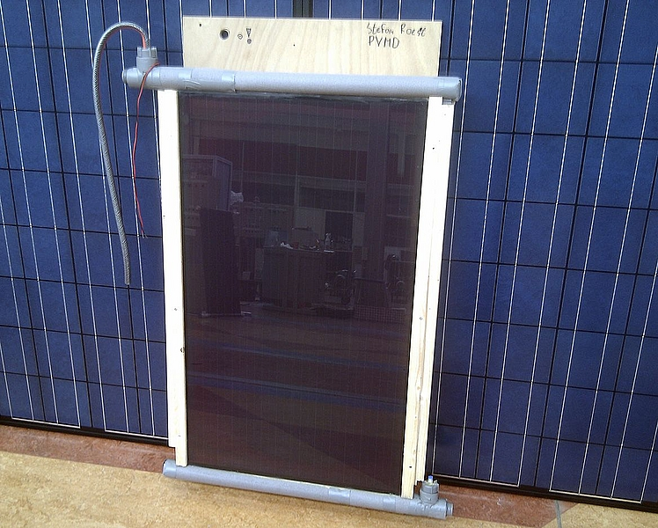
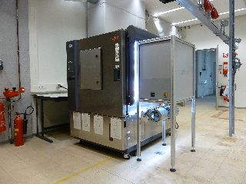
TU Delft graduate improves hybrid solar collector as well as introducing a solar simulator on the market

Slide 32
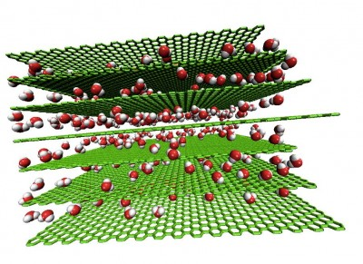
Graphite + water = the future of energy storage
A combination of two ordinary materials – graphite and water – could produce energy storage systems that perform on par with lithium ion batteries, but recharge in a matter of seconds and have an almost indefinite lifespan.

Slide 33
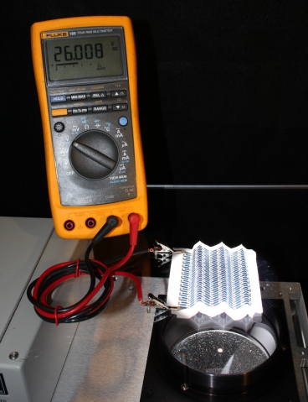
While you’re up, print me a solar cell
Developed materials make it possible to produce photovoltaic cells on paper or fabric, nearly as simply as printing a document.
-MIT
A paper solar cell that has been repeatedly folded is illuminated from below and connected to a voltmeter to demonstrate its output (26 V).

